Slide 1


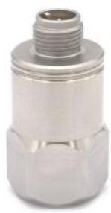
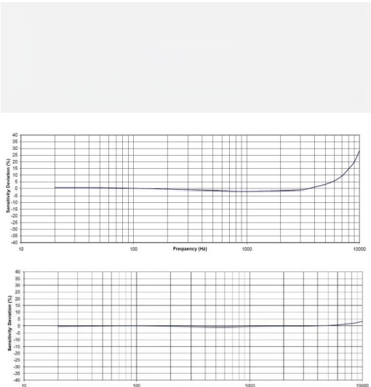
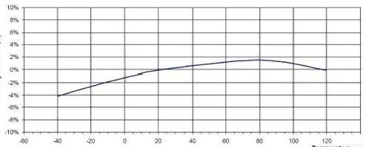
Instaguard- Device intelligent care diagnostic system
Making device care even easier
Temperature and vibration integrated wired accelerometer
Product Introduction
SD3110 is an industrial IEPE accelerometer that can perform vibration and temperature measurements simultaneously. The accelerometer includes an internal circuit and a dual-wire IEPE system that transmits its low-impedance voltage output through the same cable, providing a constant current power supply. The integrated thermal sensor transmits the output temperature through a voltage signal. The signal is internally shielded and isolated from the housing. The polarity reversal protection of the amplification circuit is inherent in the circuit design. The welded stainless steel structure provides a sealed housing. The standard M12 glass-insulated connector is provided. It offers long-term stability within the working temperature range. In addition to adhesive installation, SD3110 also has a 14-28 threaded hole for installing studs on the test object.
SD3110 can provide a wide frequency response and shock resistance, making it an ideal choice for industrial vibration monitoring in environments with accompanying shocks. Its accompanying cable model is 22A-L, so it is a sensor with an M12 connector-matched cable.
-LF Frequency Response
Prequiney p)
Wide range of applications
SD3110 is suitable for the following list of equipment monitoring:
√ Fan, pump equipment
√ Compressor
√ Gear box
√ Shaft bearing
Typical Frequency Response
Sensor Features
√ Small M12 interface
√ Corrosion resistance
√ Tight seal
√ Separate isolation
√ Electromagnetic interference/RF interference shielding
Sensitivity Doviation(%)
4
Typical Temperature Response

Slide 2
Instaguard- Device intelligent care diagnostic system
Making device care even easier
Temperature and vibration integrated wired accelerometer
Product Specifications
Dynamic range | ±10g
Sensitivity ± 10% | 500mV/g
Frequency response ±5% | 0.3-4000Hz
Frequency response ±3 DB | 0.1-10000Hz
Resonant frequency | 20Hz
Lateral sensitivity | <5%
Operating temperature -55 to 125+ °C | ± 10%
Nonlinear | ± 1%
Noise | 0.0002g RMS
Impact limit | 2000g
Response time | <2s
Weight | 87g
Parameters
Bias voltage | 10VDC to 14VDC
Power supply voltage | 18VDC to 30VDC
Supply current | 2mA to 10mA
Output impedance | <100ω
Enclosure insulation (@100V dc) | >100mω
Operating temperature | - 55℃ to 125℃
Temperature parameters
Output sensitivity | 10m V/ °C
The output voltage is 0 °C | 500m V
Accuracy | ± 1℃
Range | -40℃ to 125℃
Mechanical parameters
Housing | Airtight
Housing material | 316L stainless steel
Sensing element | Piezoelectric ceramics (shear)
Connectors | 3PinsM12
Level of protection | IP67
Insulation resistance (@500Vdc) | >200m ω
Operating temperature | -40℃ to 125 c
Note: Typical +24°C(+75°F), 2 4VDC, 4mA, and 100Hz, unless otherwise noted.

Slide 3
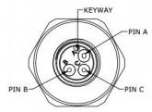
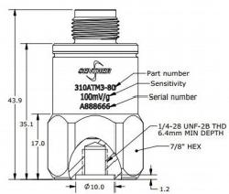
Instaguard- Device intelligent care diagnostic system
Making device care even easier
Temperature and vibration integrated wired accelerometer
Product Dimensions
 | Unit：m m
Product accessories
SerialNumber | Instructions | Remarks
1 | Install studs /4-28 to /4-28 threads | Standard configuration
2 | Install studs /4-28 to M6 threads
3 | Install studs /4-28 to M10 thread | Optional
4 | Adhesive | Optional
5 | Flat bottom magnet mounting adapter | Optional
6 | Saddle magnet mounting adapter | Optional
7 | 10 meter fit cable with M12 pin connector | Optional

