Slide 1


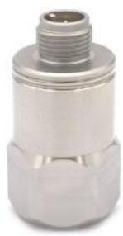
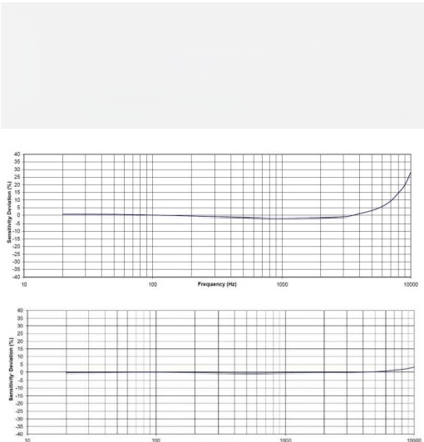
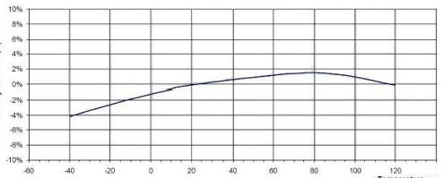
Instaguard- Device intelligent care diagnostic system
Making device care even easier
Temperature and vibration integrated wired accelerometer
Product Introduction
SD3100 Industrial IEPE accelerometer for simultaneous vibration and temperature measurement. The accelerometer includes internal circuitry with a two-wire IEPE system, which transmits its low-impedance voltage output over the same cable, providing a constant current power supply. An integrated heat sensor transmits the temperature of the output via a voltage signal. The signal is shielded internally and isolated from the housing. The polarity reversal protection of the amplifying circuit is inherent in the circuit design. Weld stainless steel construction to provide a sealed housing. Standard M12 glass cut-off connector. Provides long-term stability over operating temperature range. In addition to adhesive mounting, the SD3100 has 14-28 threaded holes for mounting studs on test objects.
The SD3100 offers broad frequency response and shock resistance, making it ideal for industrial vibration monitoring in shock environments. Cable model 22 A-L is an M12 connector matching cable transducers.
-LF Frequency Resp onse
Prequiney p)
Wide range of applications
SD3100 is suitable for the following list of equipment monitoring:
√ Fan, pump equipment
√ Compressor
√ Gear box
√ Shaft bearing
Typical Frequency Response
Sensor Features
√ Small M12 interface
√ Corrosion resistance
√ Tight seal
√ Separate isolation
√ Electromagnetic interference/RF interference shielding
Sensitivity Doviation( %)
4
Typical Temperat ure Response

Slide 2
Instaguard- Device intelligent care diagnostic system
Making device care even easier
Temperature and vibration integrated wired accelerometer
Product Specifications
Dynamic range | ±80g
Sensitivity ± 10% | 100m V/g
Frequency response ±5% | 1-7000Hz
Frequency response ±3 DB | .3-15000H z
Resonant frequency | 32Hz
Lateral sensitivity | < 5%
Operating temperature -55 to 125+ °C | ± 10%
Nonlinear | ± 1%
Noise | 0.0005g RMS
Impact limit | 5000g
Response time | <2s
Weight | 70g
Parameters
Bias voltage | 10VDC to 14VDC
Power supply voltage | 18VDC to 30VDC
Supply current | 2mA to 10mA
Output impedance | <100 ω
Enclosure insulation (@100V dc) | >100m ω
Operating temperature | - 55℃ to 125℃
Temperature parameters
Output sensitivity | 10m V/ °C
The output voltage is 0 °C | 500m V
Accuracy | ± 1 ° C
Range | -40℃ to 125℃
Mechanical parameters
Housing | Airtight
Housing material | 316L stainless steel
Sensing element | Piezoelectric ceramics (shear)
Connectors | 3PinsM12
Level of protection | IP67
Insulation resistance (@500Vdc) | >200m ω
Operating temperature | -40℃ to 125 c
Note: Typical +24°C(+75°F), 2 4VDC, 4mA, and 100Hz, unless otherwise noted.

Slide 3
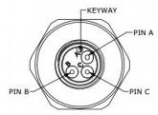
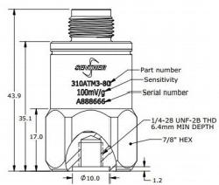
Instaguard- Device intelligent care diagnostic system
Making device care even easier
Temperature and vibration integrated wired accelerometer
Product Dimensions
 | Unit: mm
Product accessories
SerialNumber | Instructions | Remarks
1 | Install studs /4-28 to /4-28 threads | Standard configuration
2 | Install studs /4-28 to M6 threads
3 | Install studs /4-28 to M10 thread | Optional
4 | Adhesive | Optional
5 | Flat bottom magnet mounting adapter | Optional
6 | Saddle magnet mounting adapter | Optional
7 | 10 meter fit cable with M12 pin connector | Optional

